Slide 1
Data Visualisation Project

Slide 2
Project Flow Structure
Step 1: Exploratory Data Analysis
Explore Dataset, Identify datatypes
Understand column data
Create Hieararchies in Tableau
Create basic visualizations and explore data
Step 2: Come up with questions
Identify aspects of data you want to work with
Come up with questions

Slide 3
Project flow structure
Step 3: Plan out Dashboard
Identify what kind of visualisations are needed to answer questions
Plan out how you want to organise the dashboard
Step 4: Create Dashboard

Slide 4
Data Questions
General Information
Distribution of number of strikes?
Breakdown of types of animals struck?
Date/Time Information
Trend for strikes over time?
Which Month had the most amounts of strikes?
Damage causing strike Information
Which Phase of flight?
What time of day?
Amount of damage caused vs Impact on flight?

Slide 5
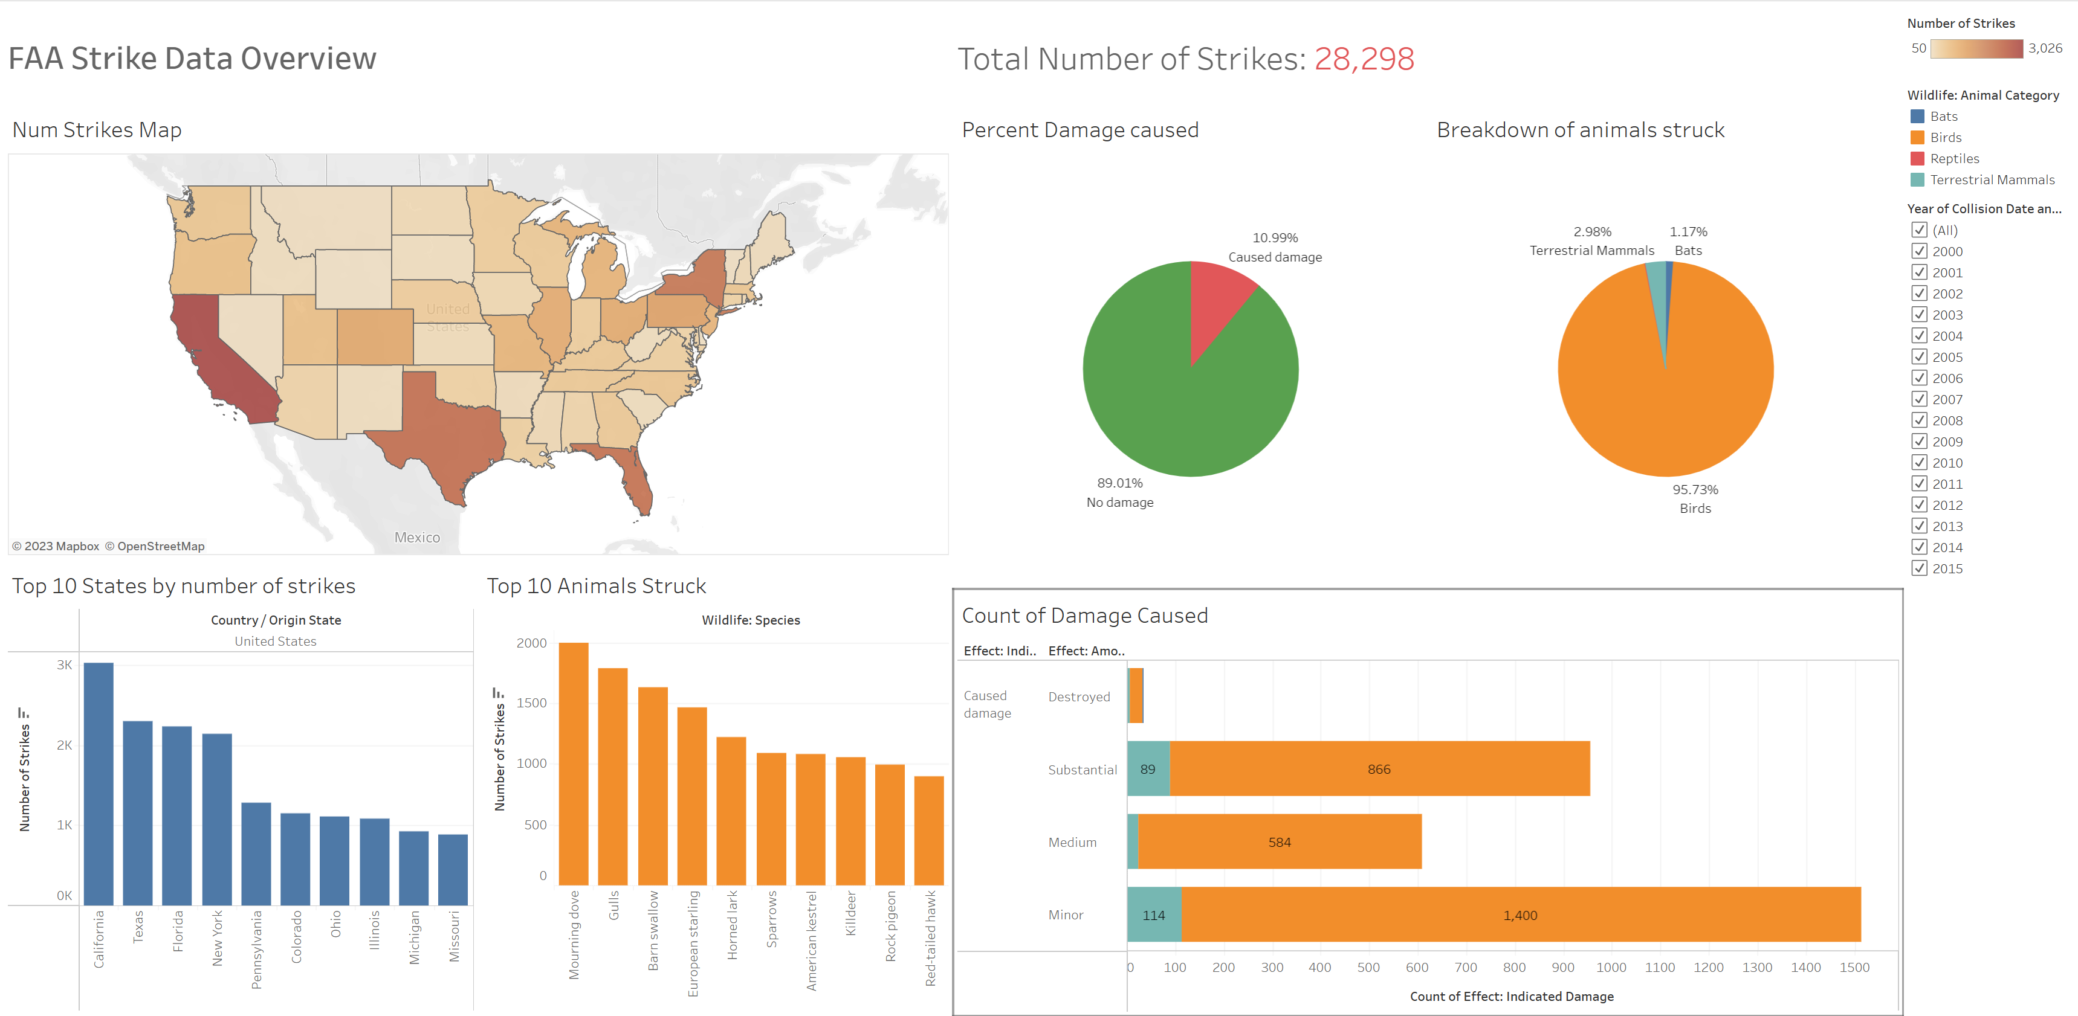
Results
Notes:
Also Explain Why I chose the charts I chose

Slide 6
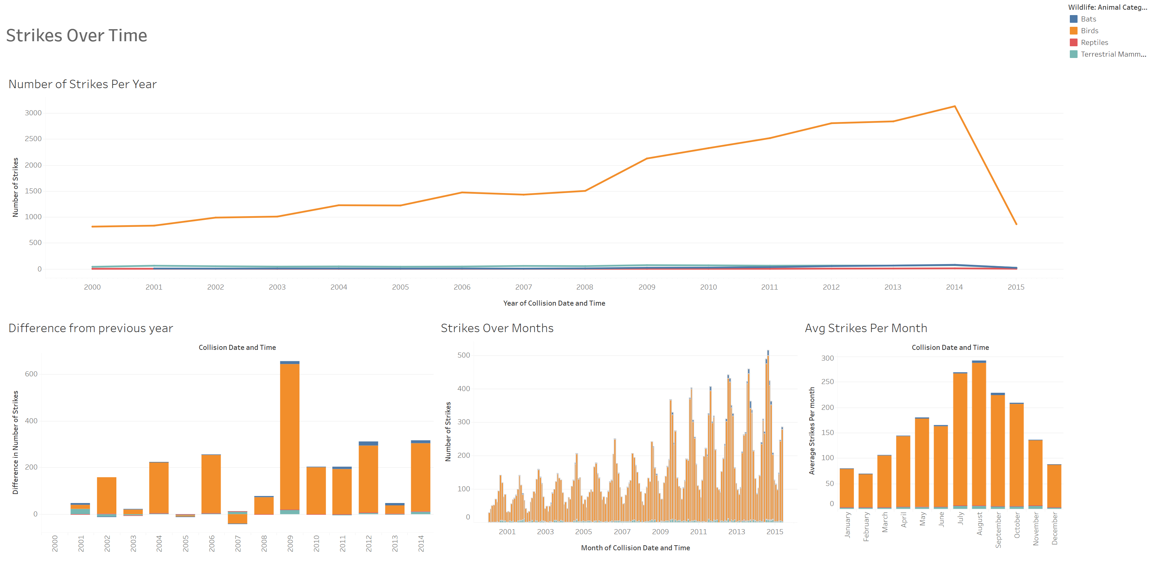
Results
Notes:
Also Explain Why I chose the charts I chose

Slide 7
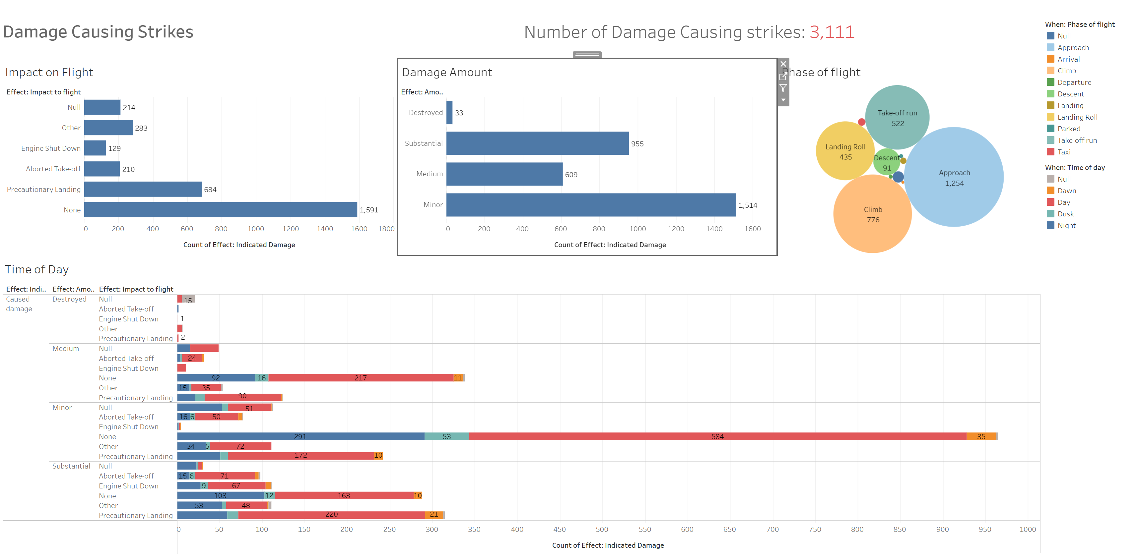
Results
Notes:
Also Explain Why I chose the charts I chose

Slide 8
Challenges + Future Goals
Tableau Web was missing some features compared to desktop version
Would have liked to add a forecast
Make the visualizations prettier by exploring more customization options
Notes:
Desktop version was laggy for me so I chose to work on the web version, however it didn’t have clustering or forecasting features

Slide 9
Thanks for listening! Questions?

